Slide 1


Slide 2
Robotics Workshop
July 2024

Slide 3
What are your expectations?

Slide 4
Goals?

Slide 5
Who am I?
Ben Wesse
Student at Alpen Andria Universität - Austria
Robotics and Artificial Intelligence
NATO project member

Slide 6
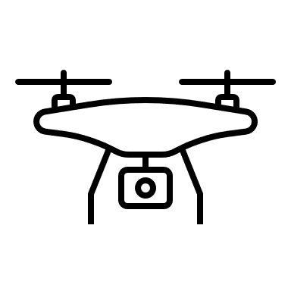
NATO – project - SAPIENCE
Autonomous collaborative UAV’s for in- and Outdoor S&R operations

Slide 7

What is a robot?

Slide 8
What do we need to build a Robot?

Slide 9

What do we need to build a Robot?
Mimic and extend human abilities

Slide 10

What do we need to build a Robot?
Mimic and extend human abilities

Slide 11







What do we need to build a Robot?
Mimic and extend human abilities

Slide 12
What do we want a robot to do
Mimic and extend human abilities
Sense Think Act Communicate

Slide 13
How do we achieve this?
Mimic and extend human abilities
Sense Think Act Communicate

Slide 14



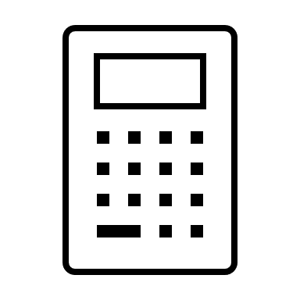




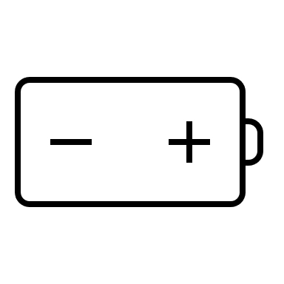





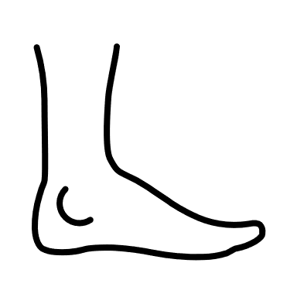

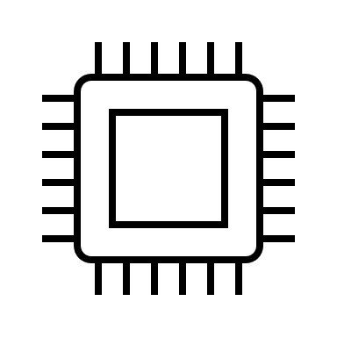
What do we need to build a Robot?

Slide 15
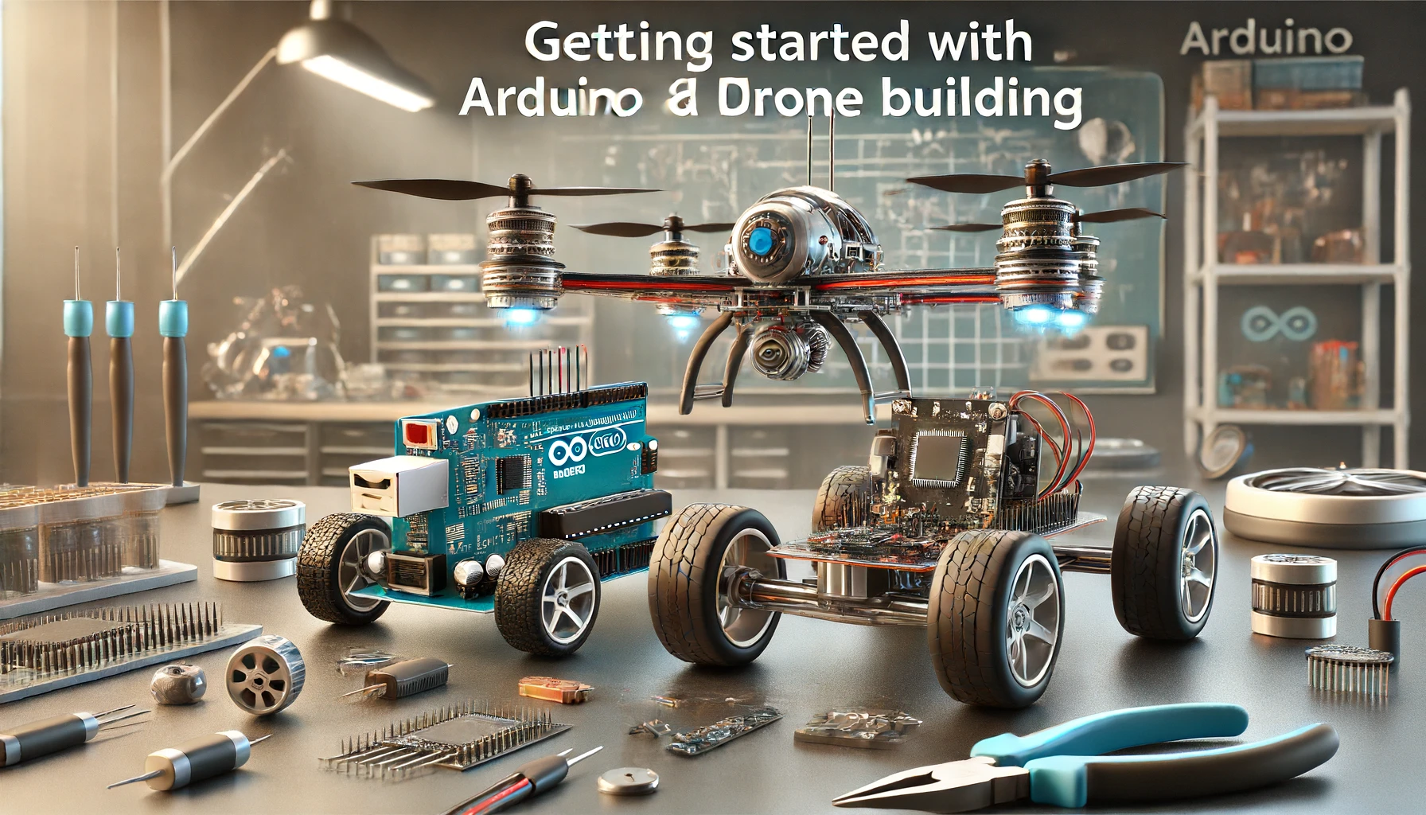
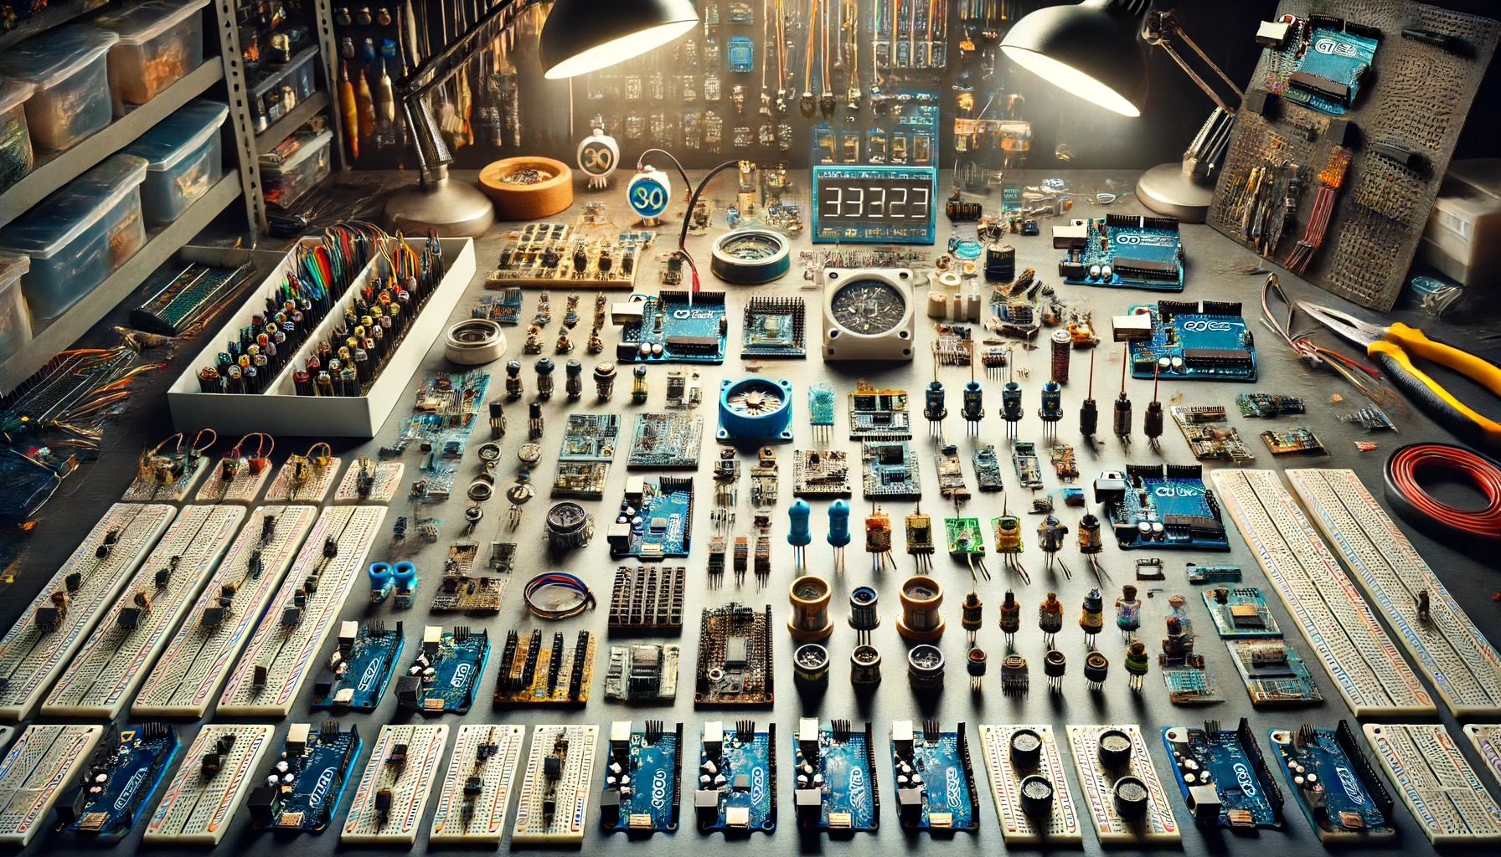
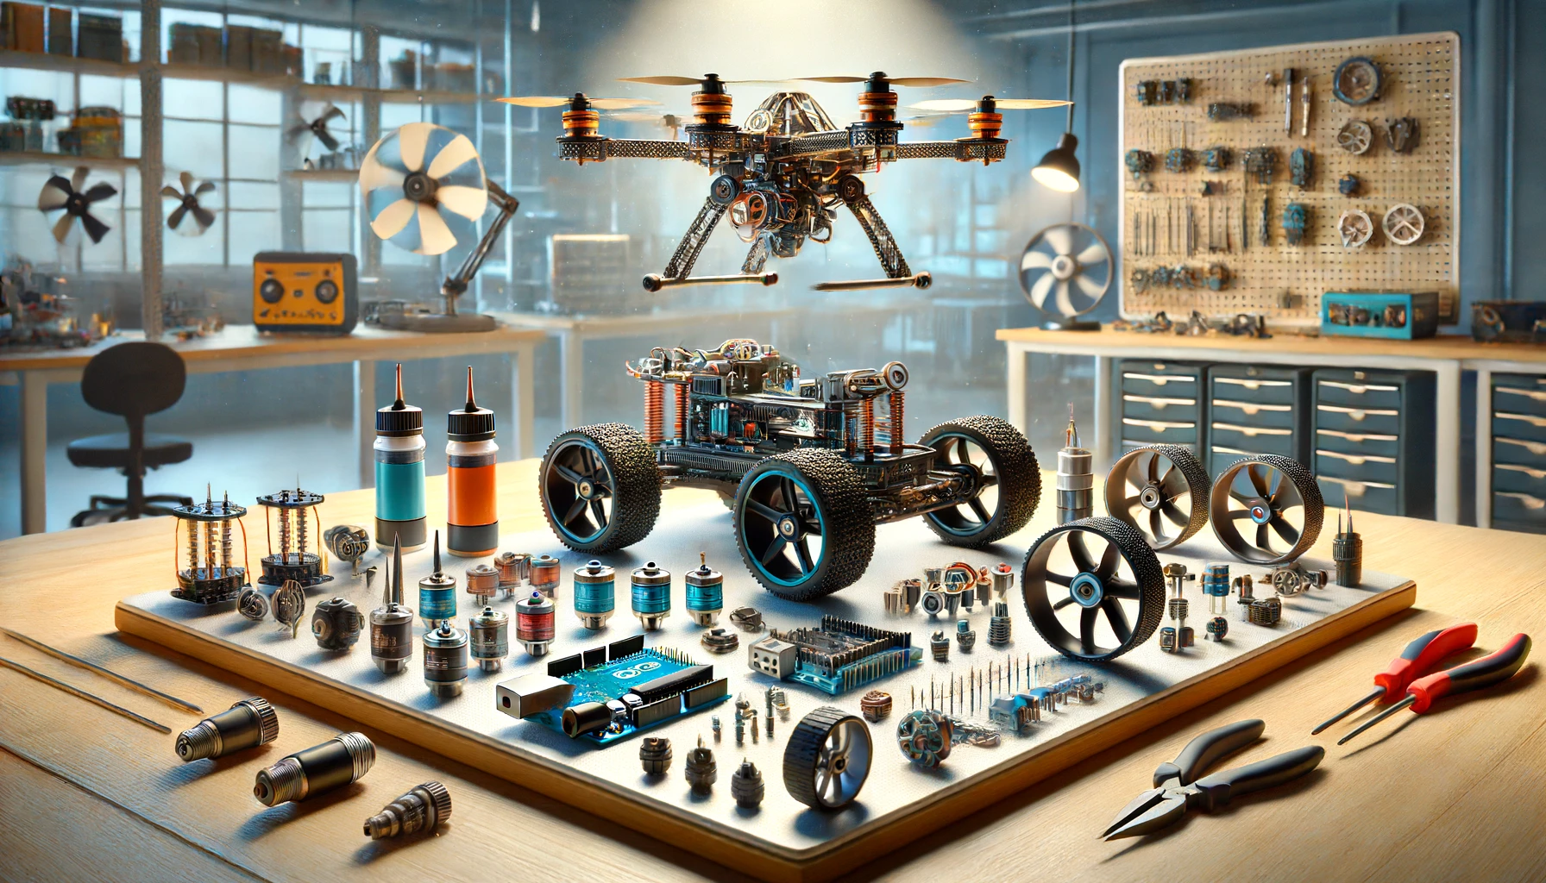


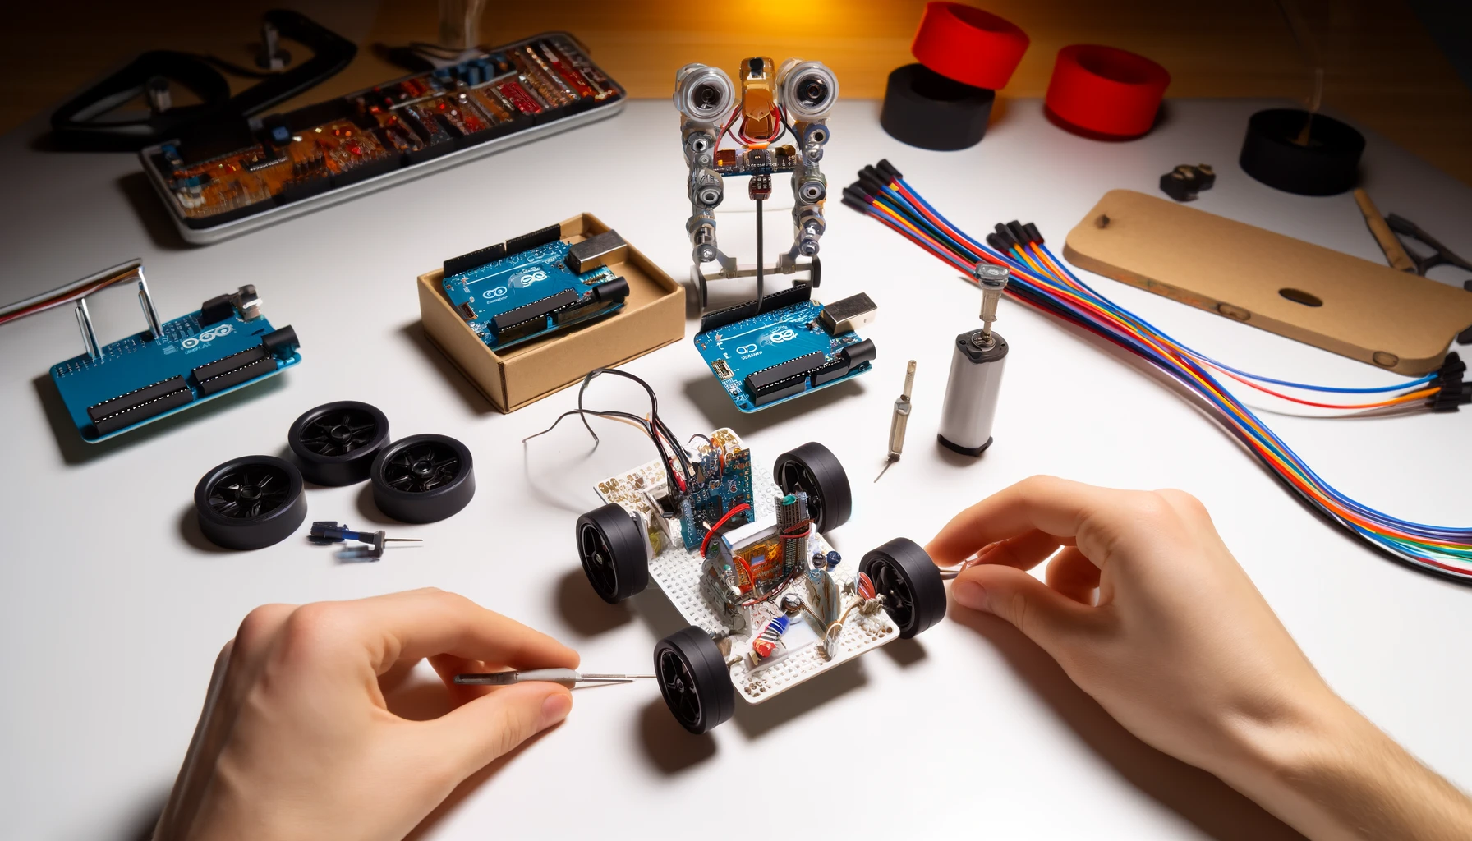
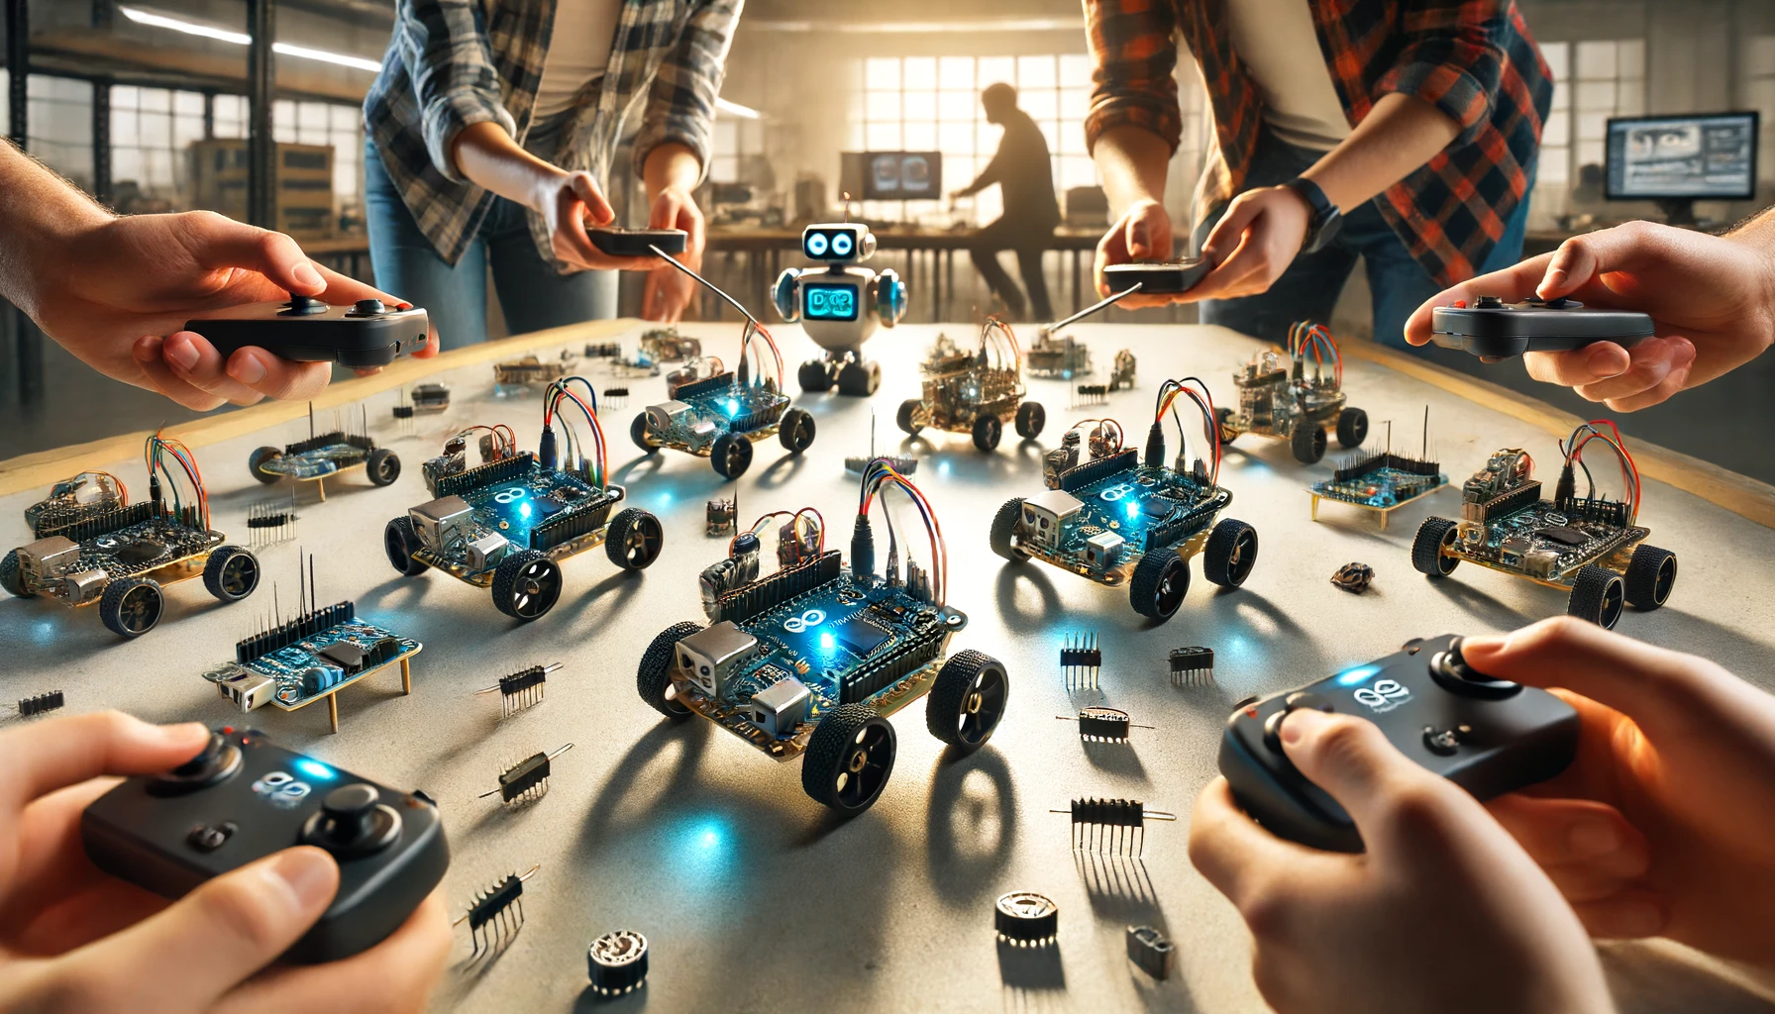
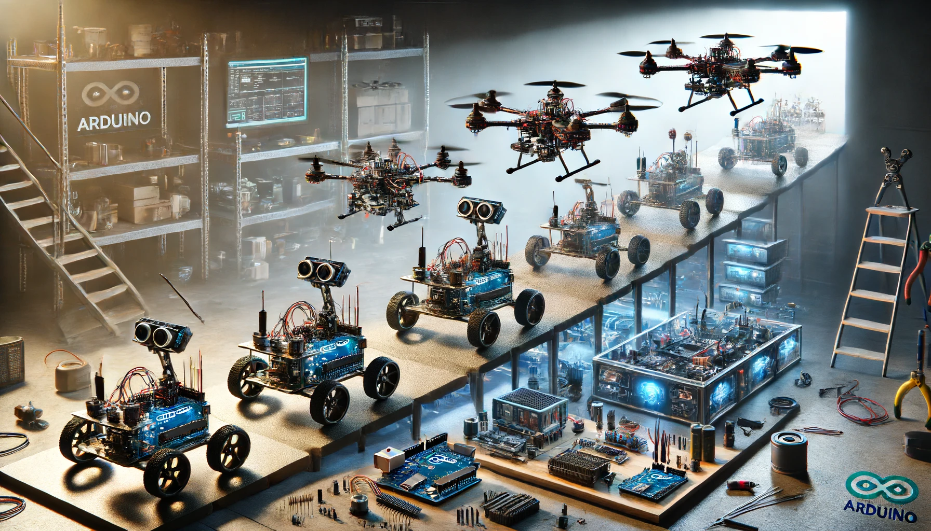

Getting started Sensors Actuators
Electricity in Robotics Communication Assemble
Drive Transition to Drone Outlook

Slide 16
Day one
Getting started
Arduino
Breadboards, LED’s etc.
Sensors
Inertial Measurement Unit – MPU6050
ToF – VL0
Actuators
Motor driver – L298
Gearmotors – N20

Slide 17
Day two
Electricity in Robotics
Terms
Precautions
Applications
Communication
Protocols
Nrf24
Remote
Assembly
Putting everything together

Slide 18
Day three
Driving
Ready?
Set
Go!
Transition to drone
Comparison ground to air
UAV components
Outlook
What’s next?

Slide 19


How will the lessons work?
Accompanying Website
https://bwesse.github.io/robo_workshop.github.io/
Five robots - Five teams
New components in each lesson
Tasks
Starting – Intermediate – Advanced
Ask Questions & help each other
Discussion

Slide 20

Questions?

Slide 21
Let’s get started

Slide 23
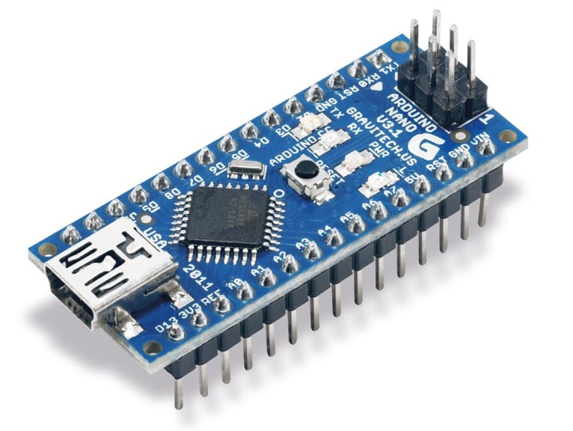
Arduino Nano
Popular microcontroller
Acts as the brain
Executes flashed program on repeat
36 kilo bytes internal storage
General Purpose Input Output (GPIO) pins for connection

Slide 24
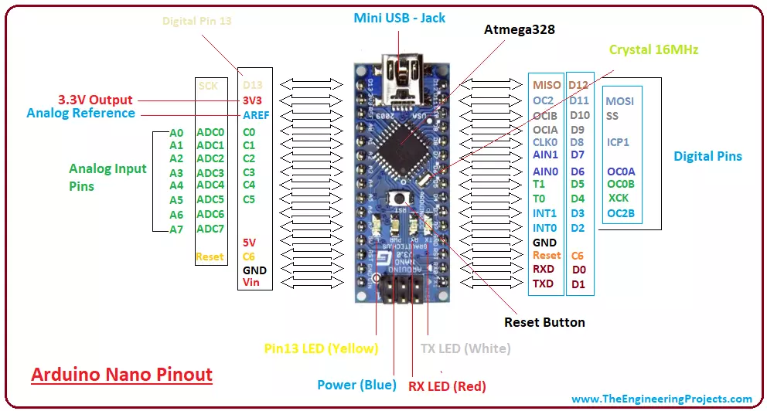

Slide 25
How do we tell the controller what to do?

Slide 26

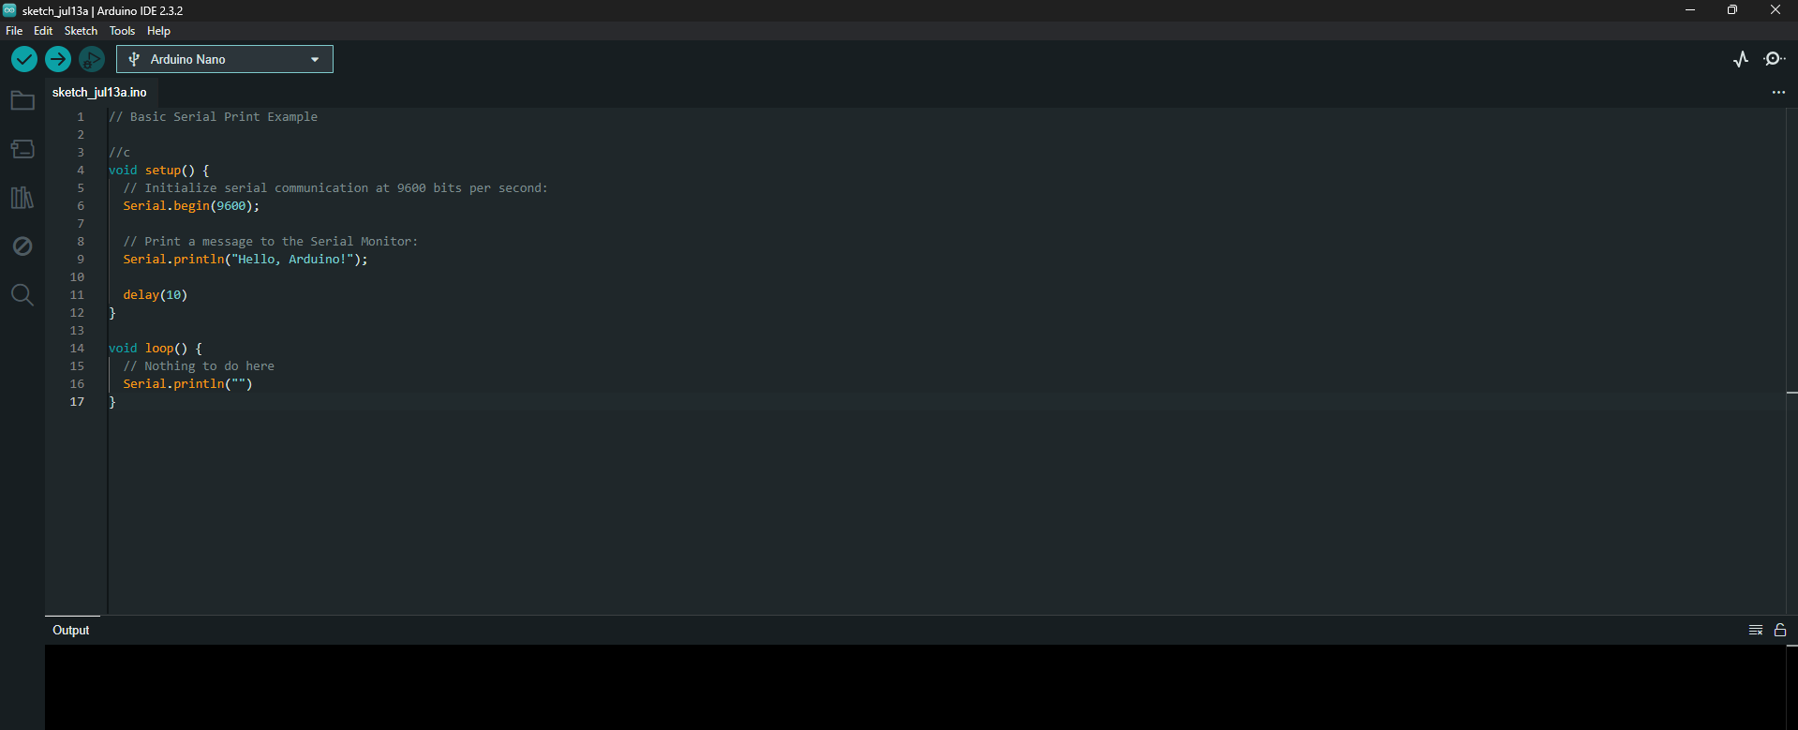
Arduino IDE
https://www.arduino.cc/en/software

Slide 27
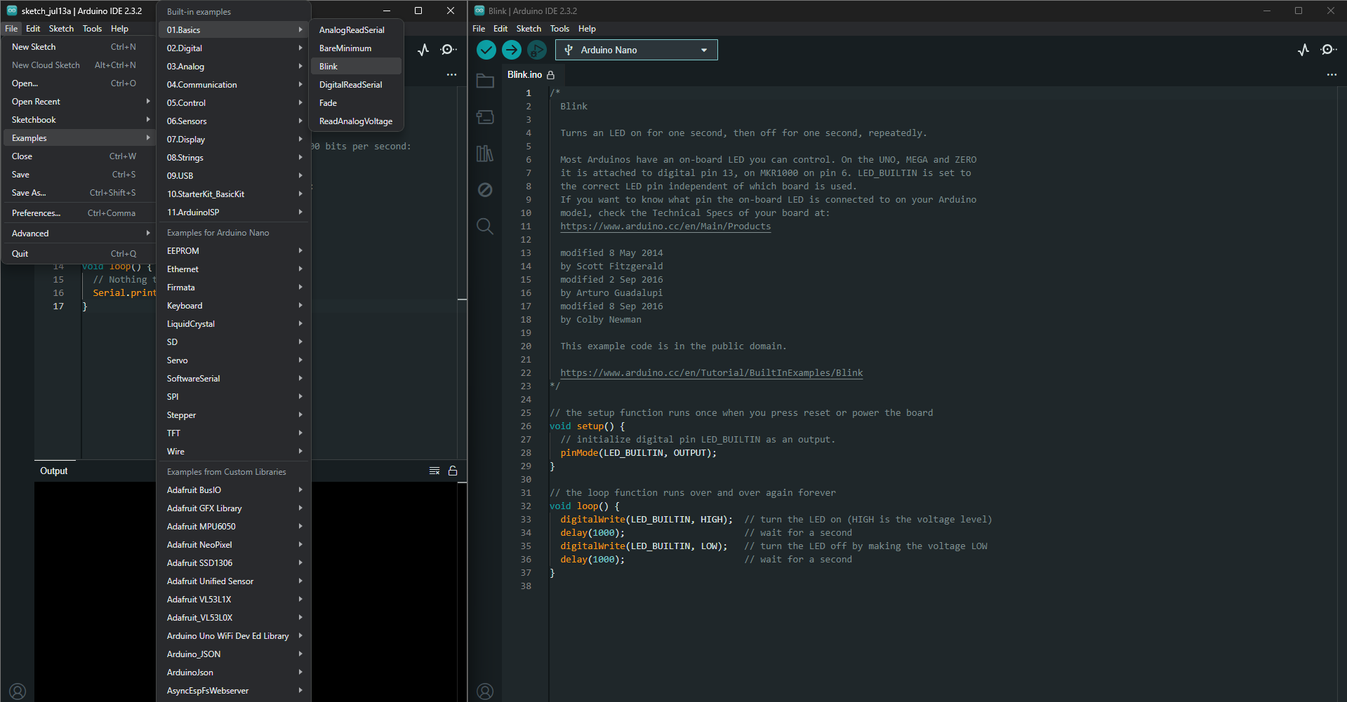
Open Arduino -> file -> Examples -> 01.Basics -> Blink

Slide 28
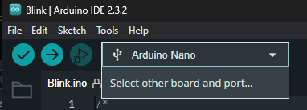
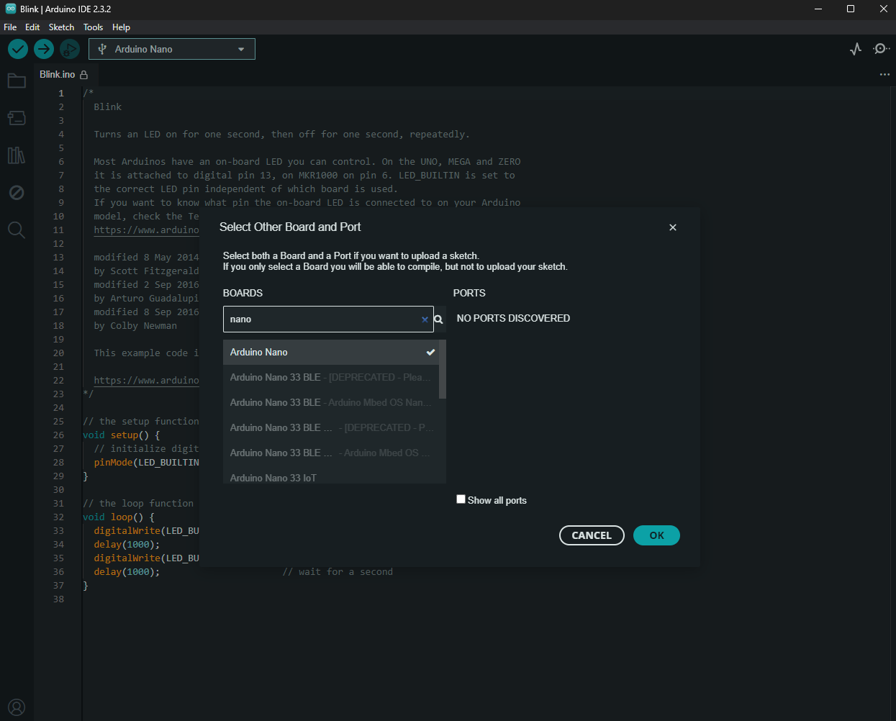
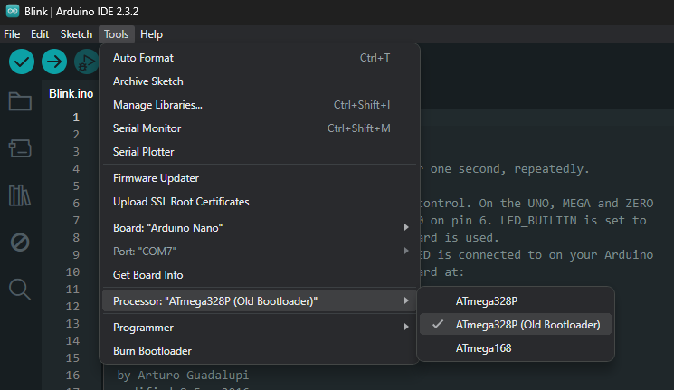
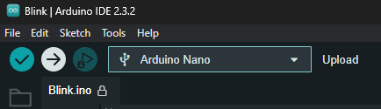

…-> Blink -> connect Arduino Nano to Usb -> select board -> tools -> old bootloader
Search for Arduino nano
Select Port here

Slide 30
Serial Print

Slide 31
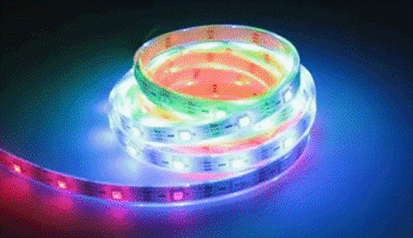
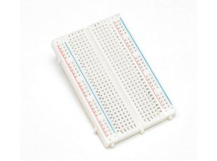
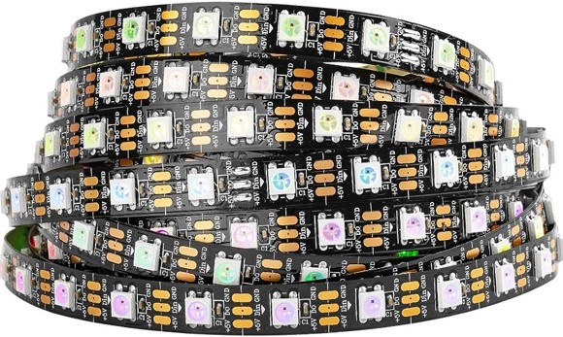
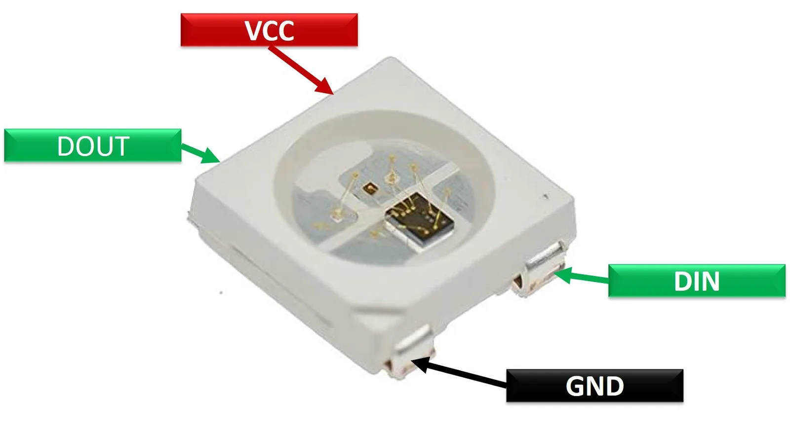
Components
Arduino Nano
Mini-usb-cable
Breadboard
LED’s

Slide 32
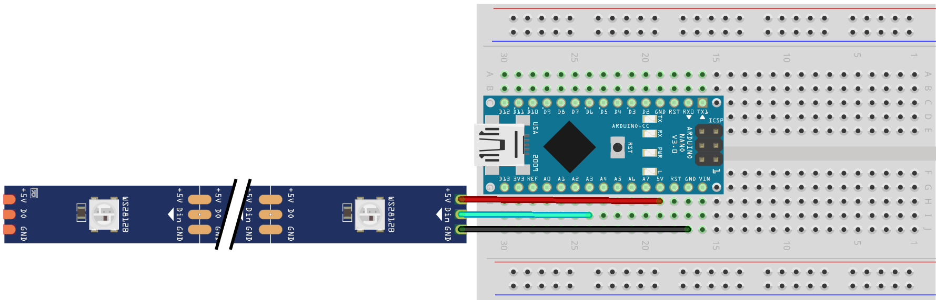
Diagram
How to read wire-grams?

Slide 33

Discussion
Open Questions?
I sure hop not

Slide 34
Sensors

Slide 35
How can we perceive our world?

Slide 36
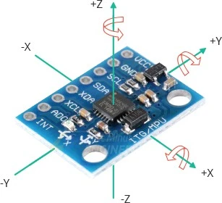
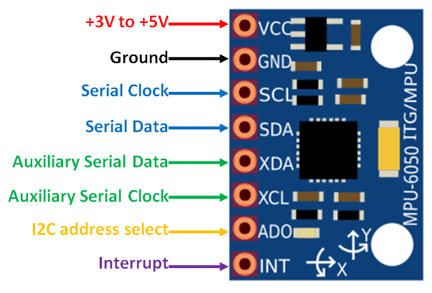
Inertial Measurement Unit

Slide 37
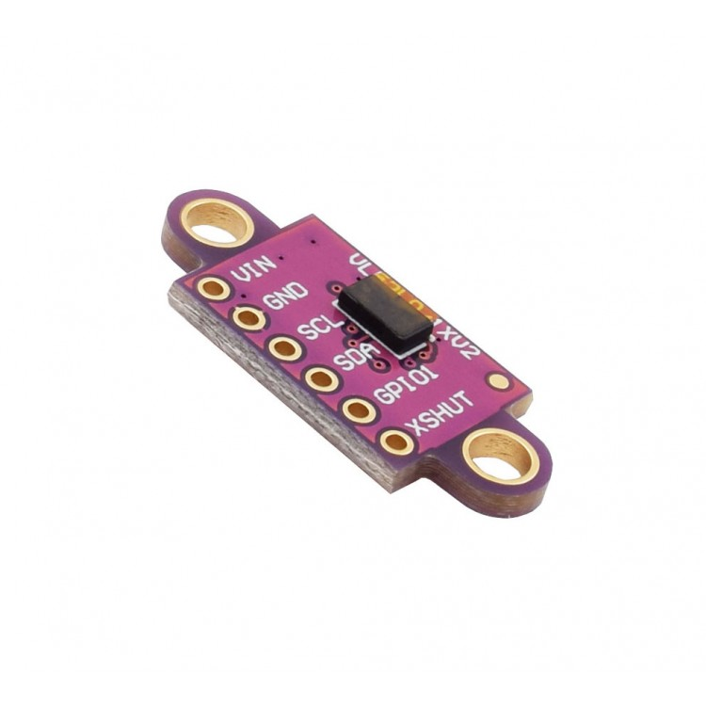
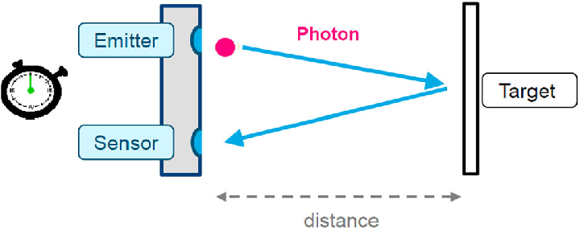
Time of Flight

Slide 38
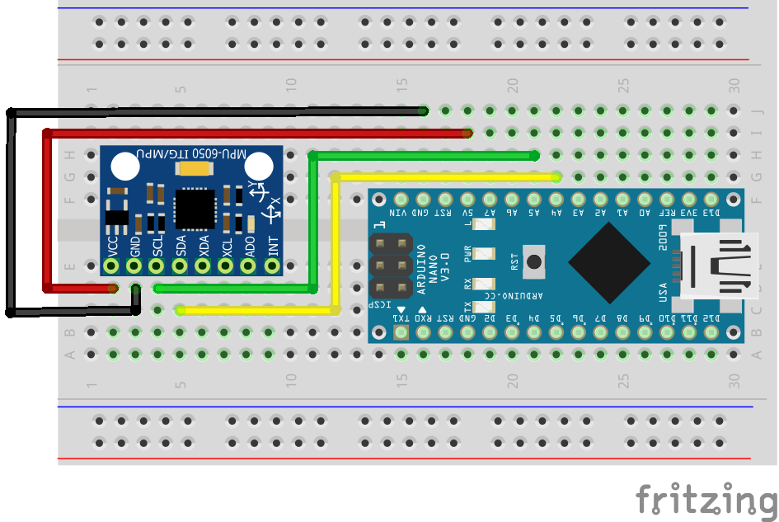
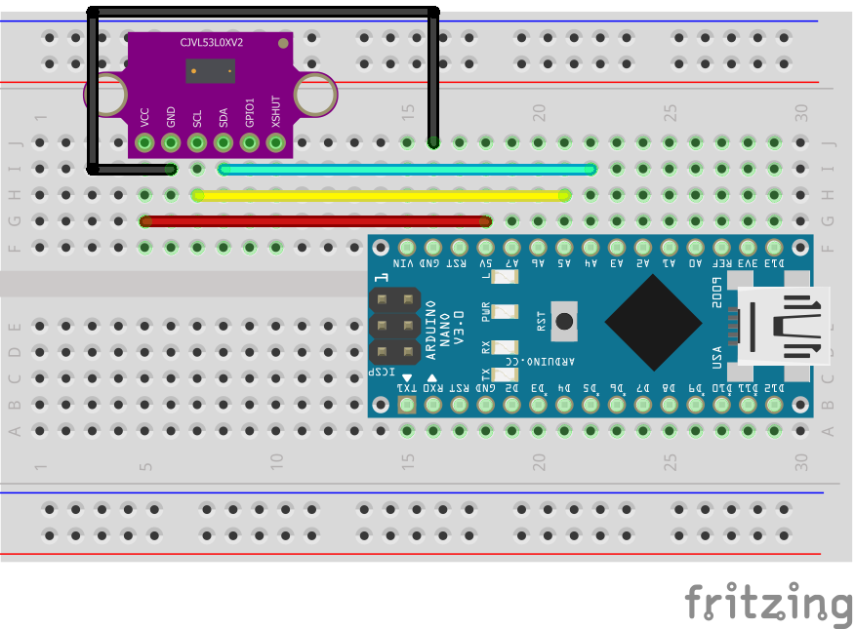
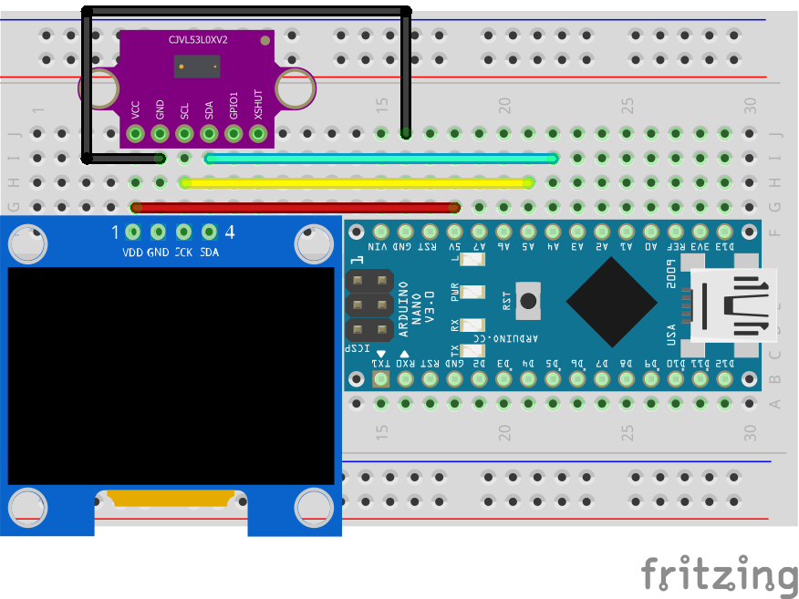
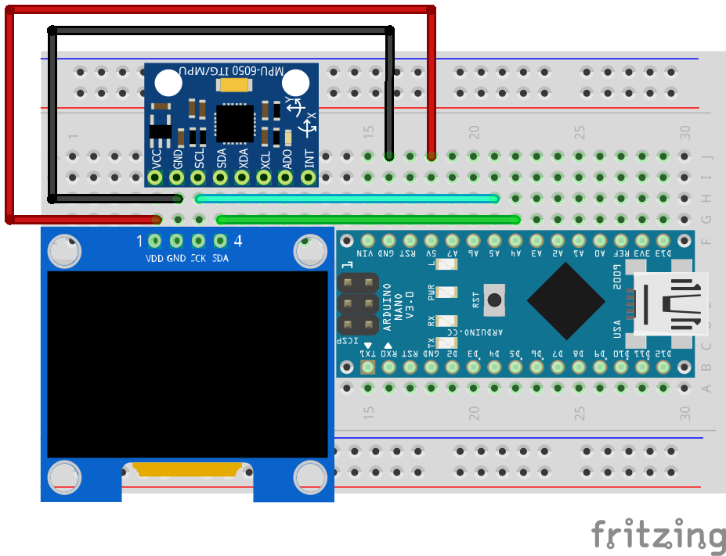
Diagram

Slide 39
Task:
Use a ToF sensor to measure distances
Use an IMU to measure acceleration in x, y, z and rotation roll, pitch, yaw

Slide 41
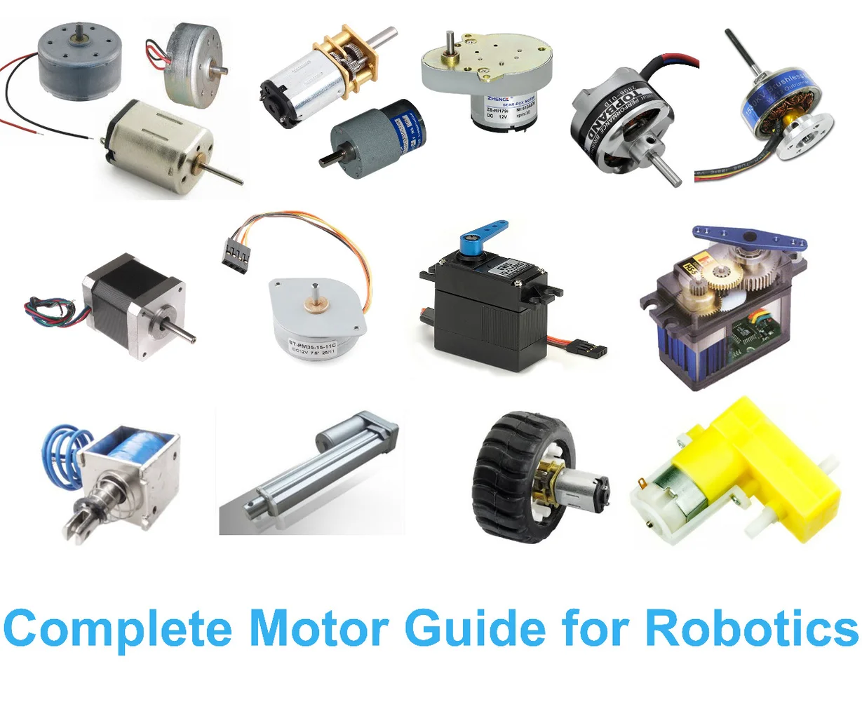

Slide 42
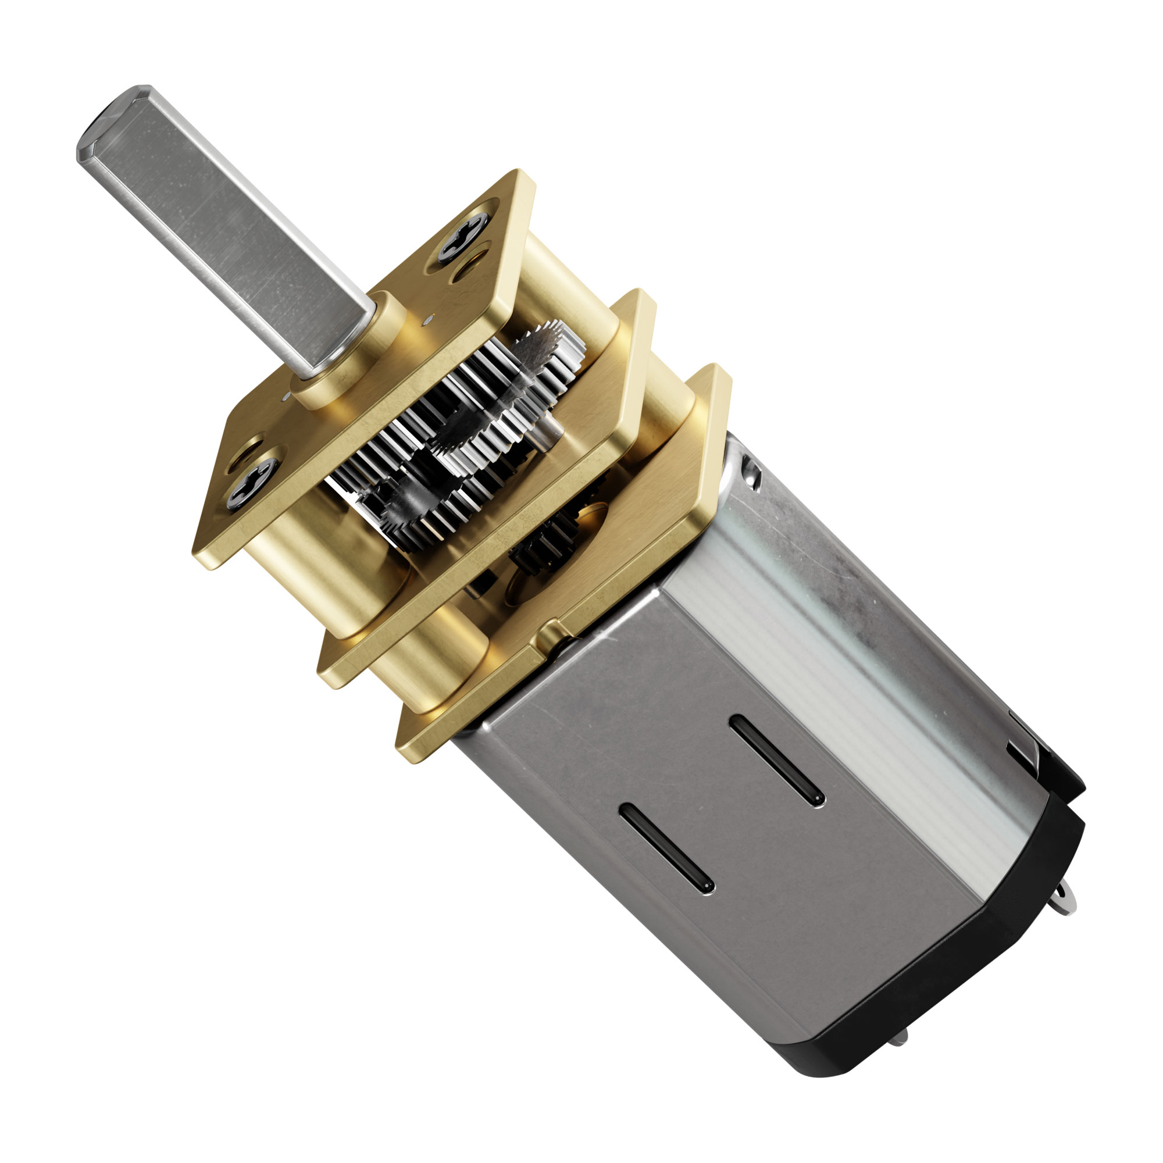
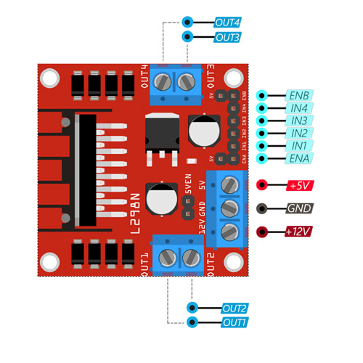

Slide 43
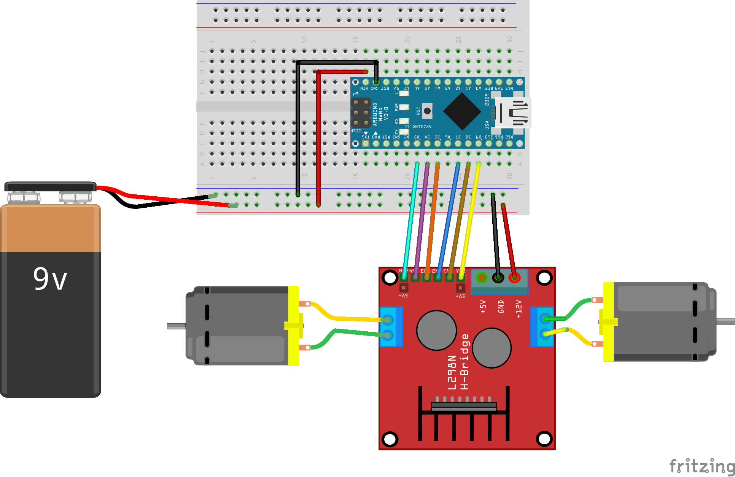
Diagram

Slide 45
How do we communicate?

Slide 46
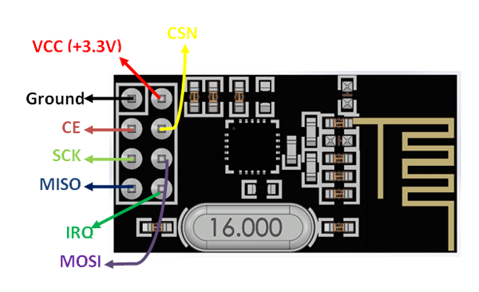
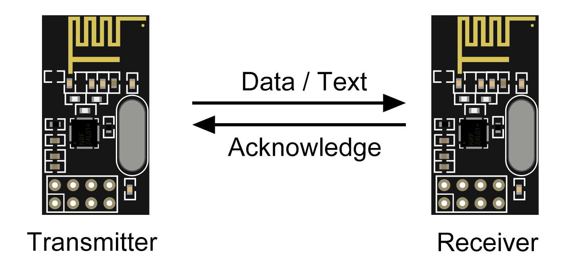
NRF24

Slide 47
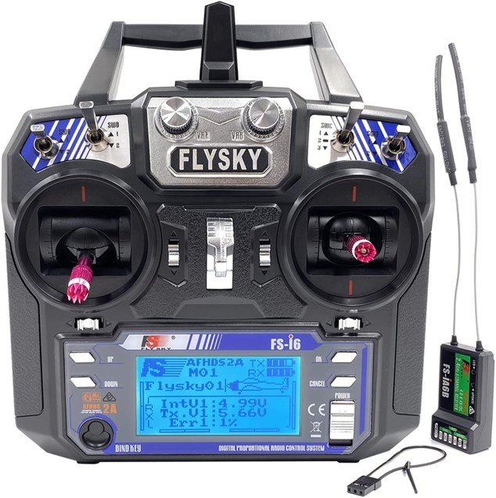
Remote

Slide 50
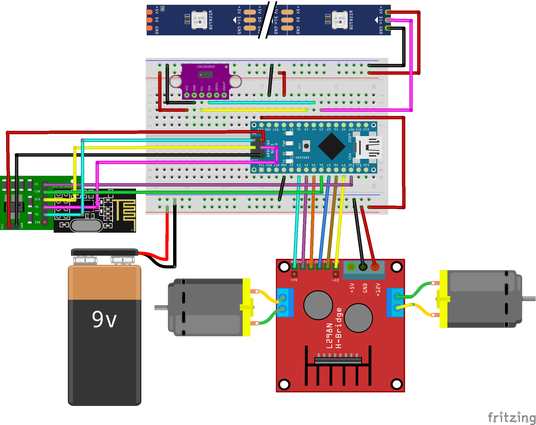
Receiver

Slide 51
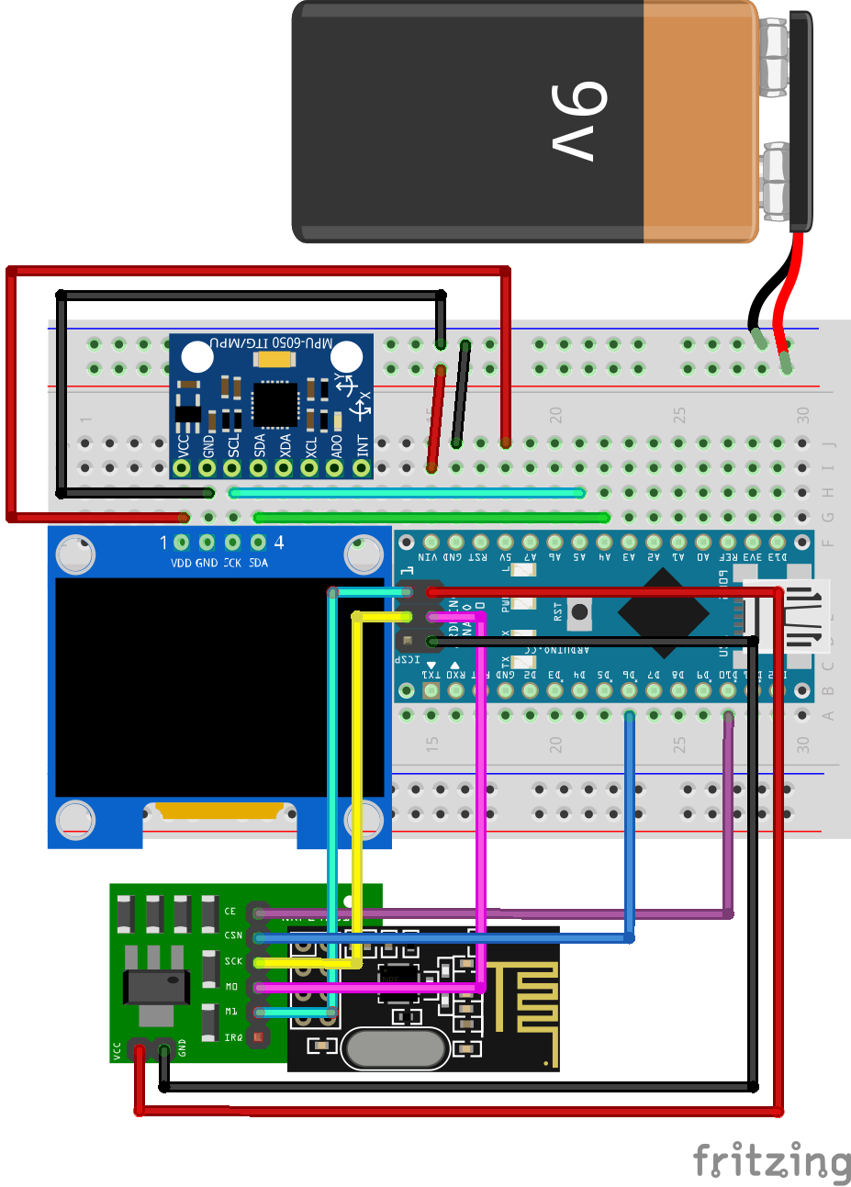
Transmitter

Slide 56

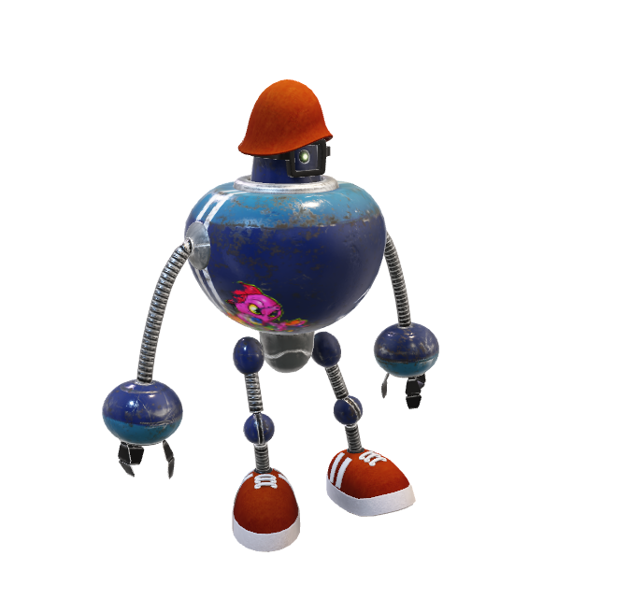
What comes next?

